Slide 1
Deep Learning
Computer Vision
Artem Chumachenko

Slide 2
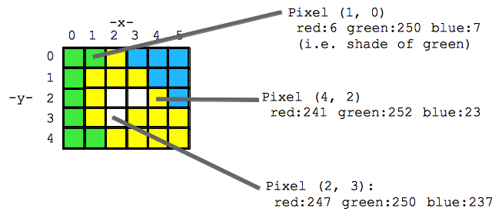
Images & Videos

Slide 3

Computer Vision Problems

Slide 4
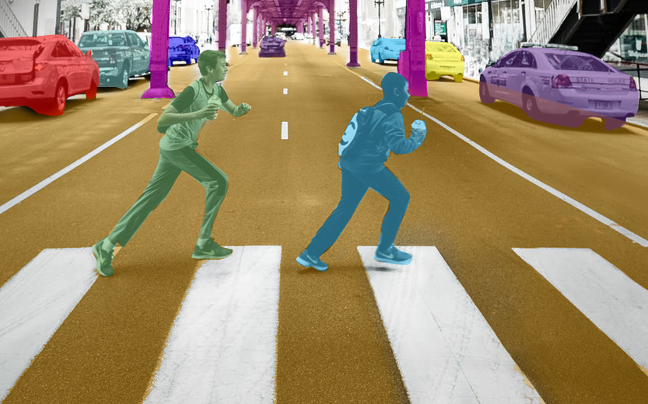
Computer Vision Problems

Slide 5
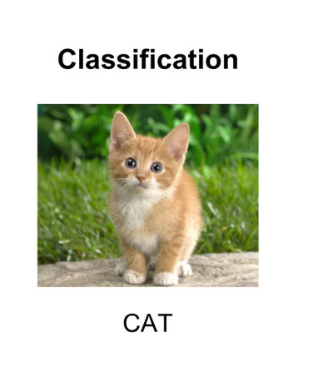
Computer Vision Problems

Slide 6
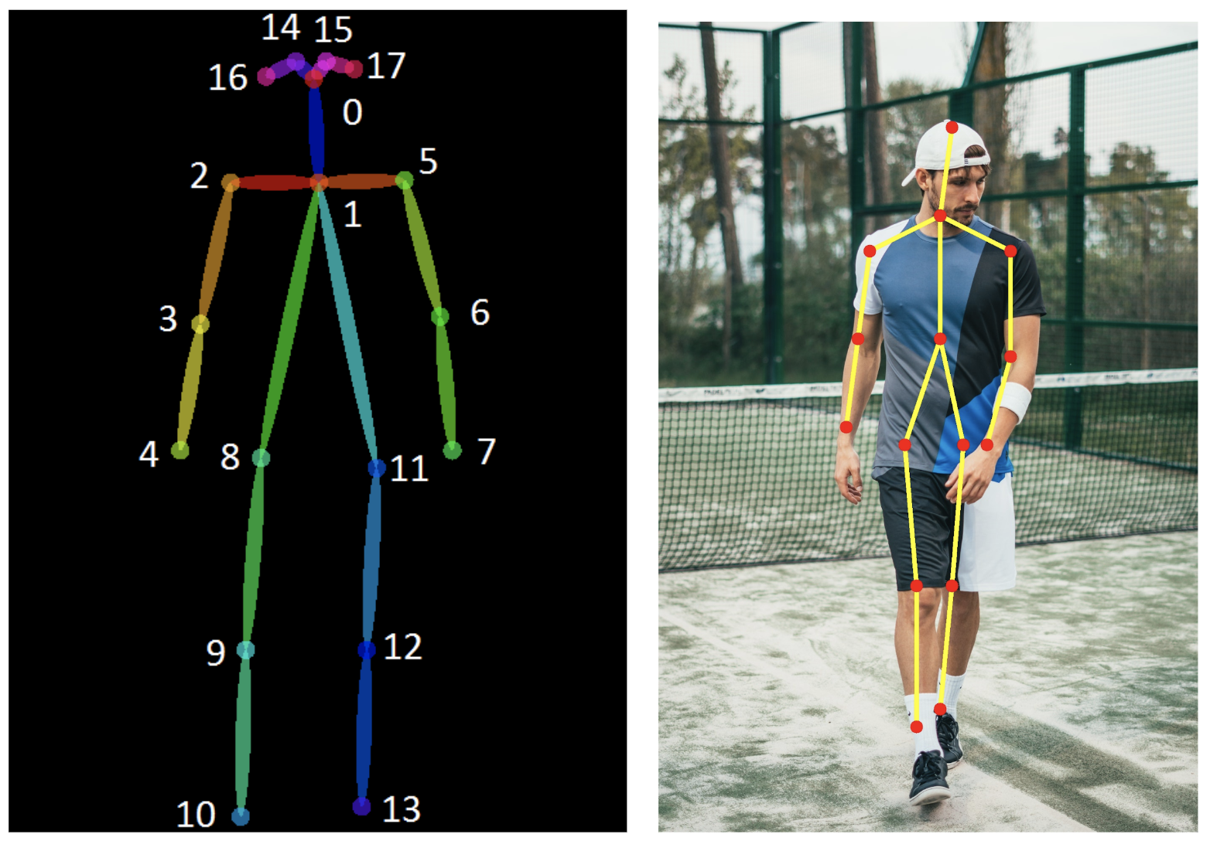
Computer Vision Problems

Slide 7
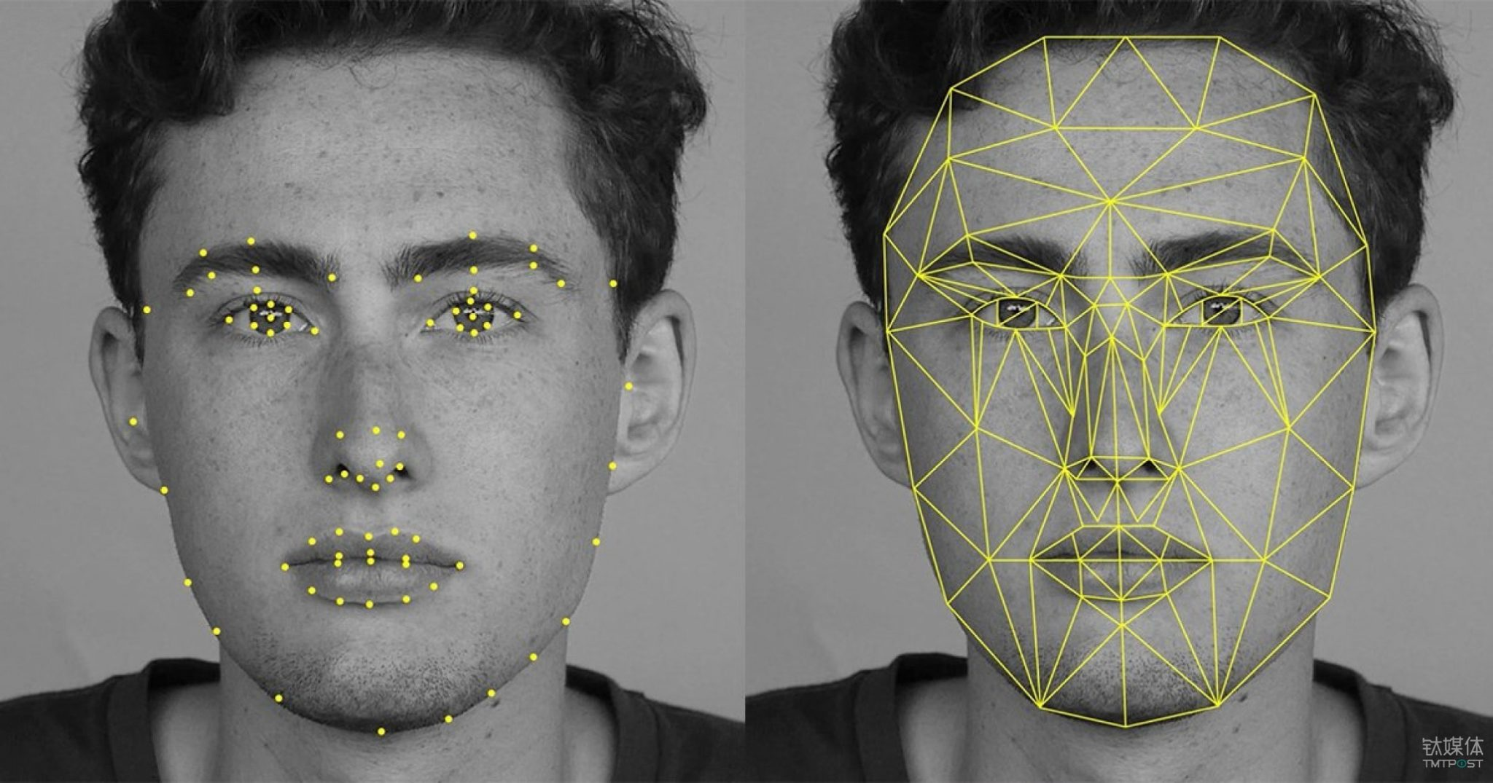
Computer Vision Problems

Slide 8
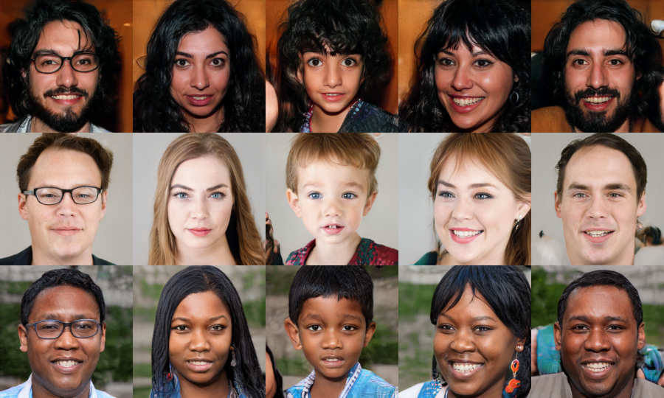
Computer Vision Problems

Slide 9
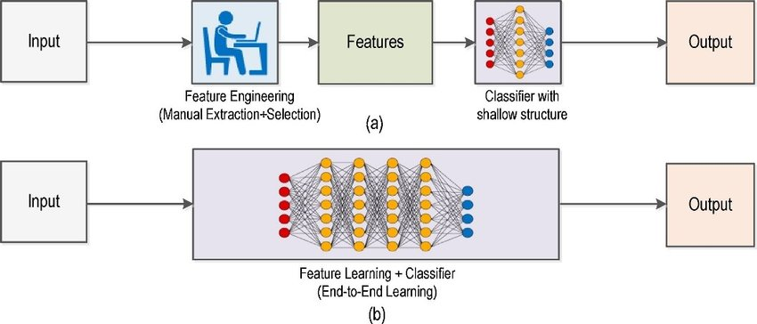
Old School

Slide 10
Now we have DNN

Slide 11
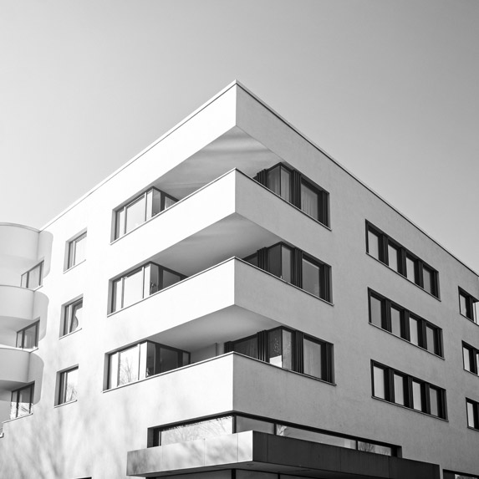
Images

Slide 12
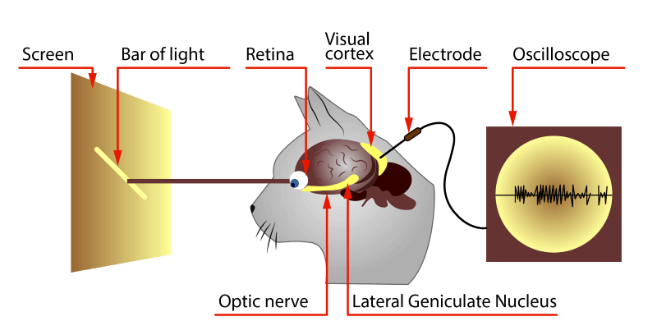
Convolution

Slide 13
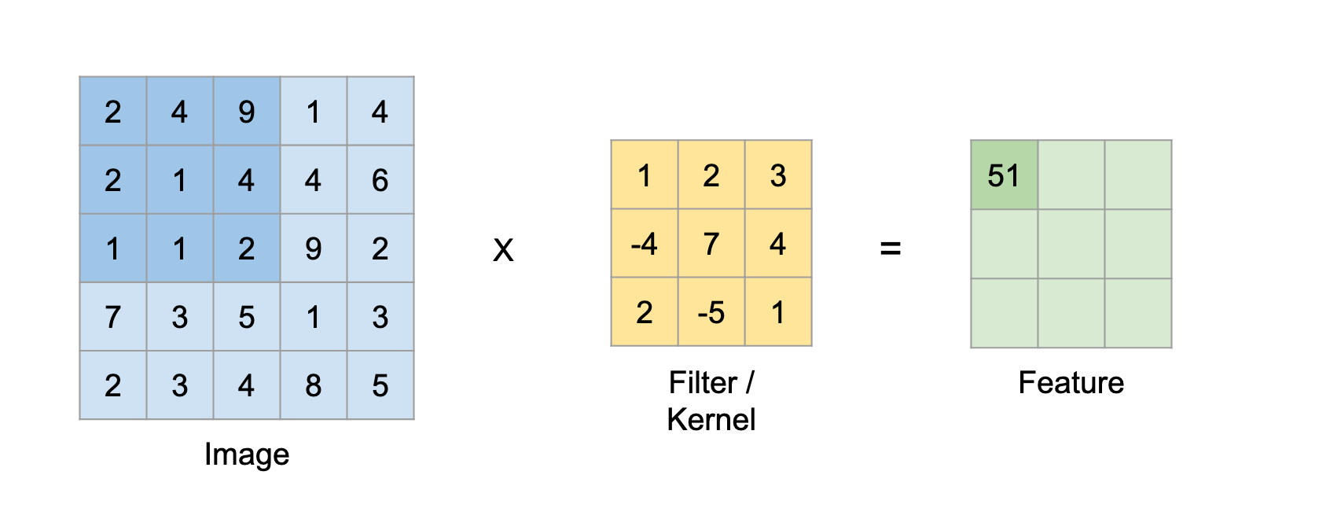
Convolution

Slide 14
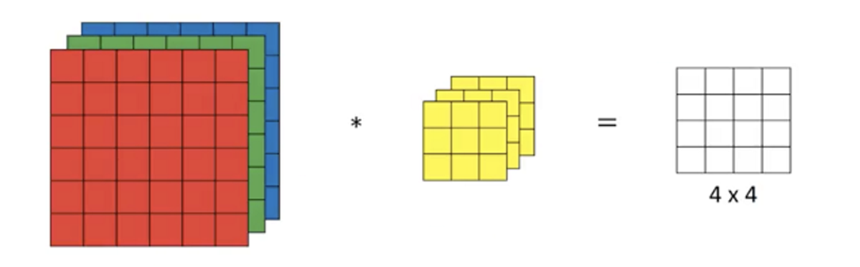
Convolution

Slide 15
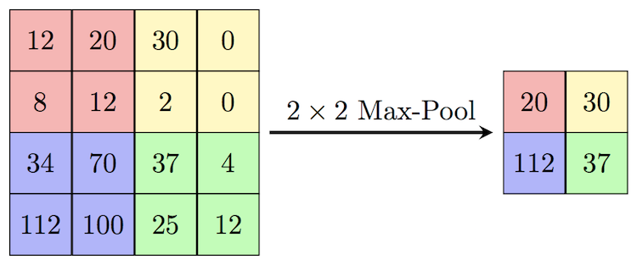
Pooling

Slide 16
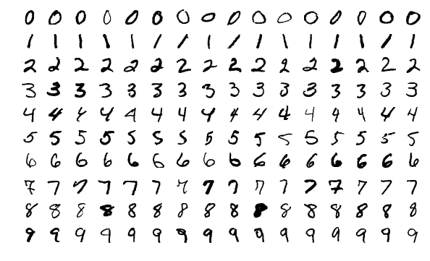
LeNet

Slide 17
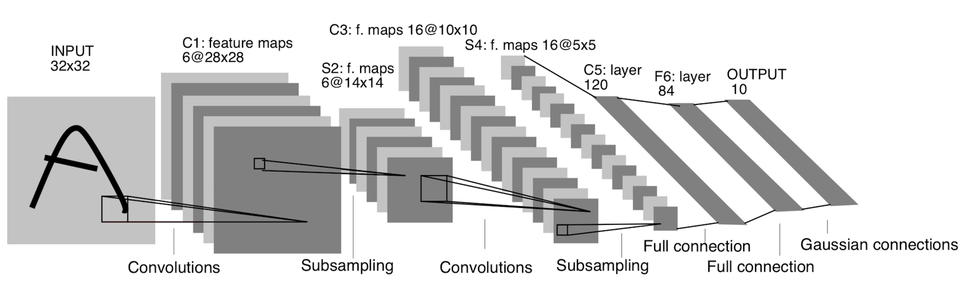
LeNet

Slide 18

ImageNet

Slide 19
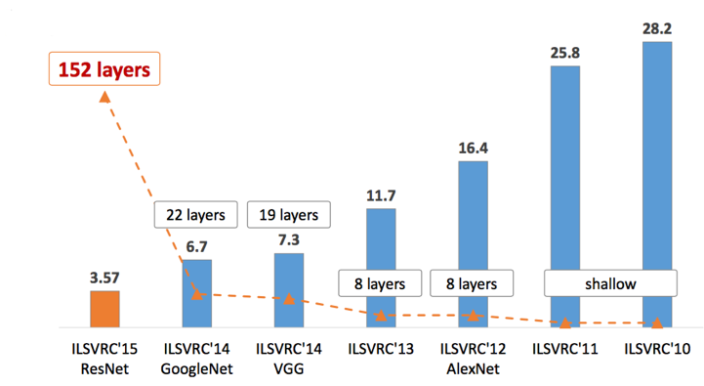
AlexNet

Slide 20
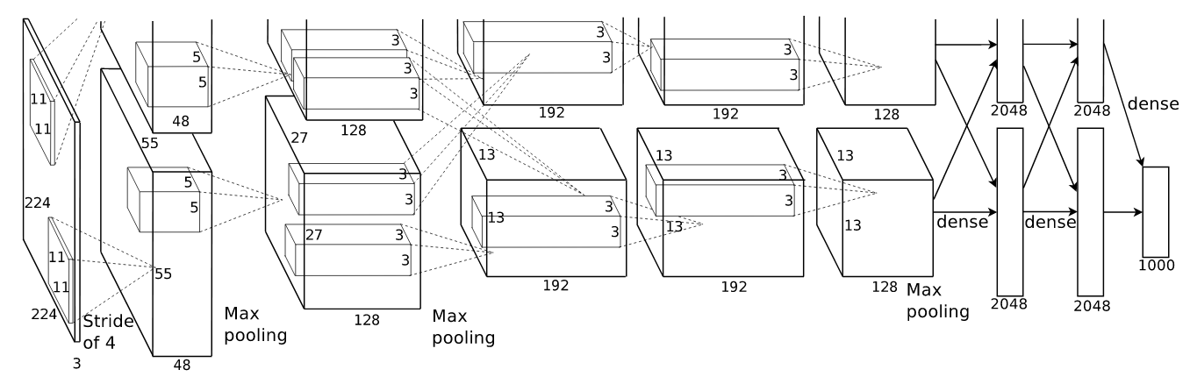
AlexNet

Slide 21
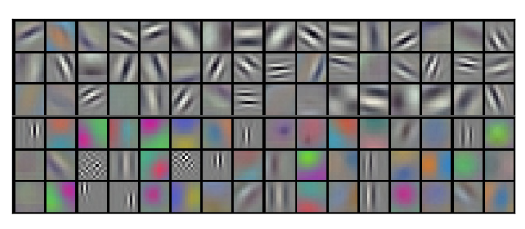
Kernels

Slide 22
VGG

Slide 23
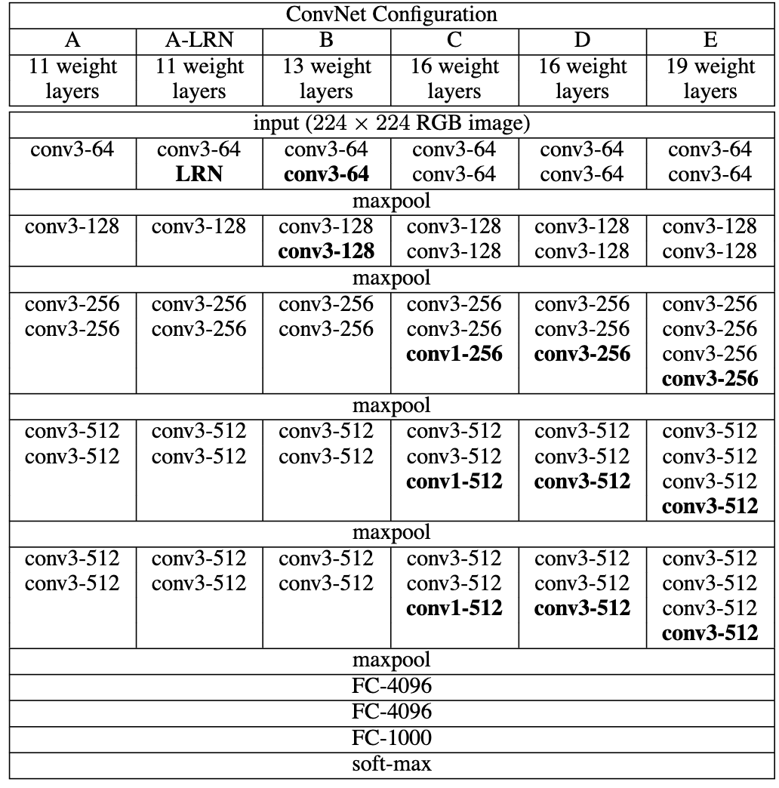
VGG

Slide 24
Going deeper

Slide 25
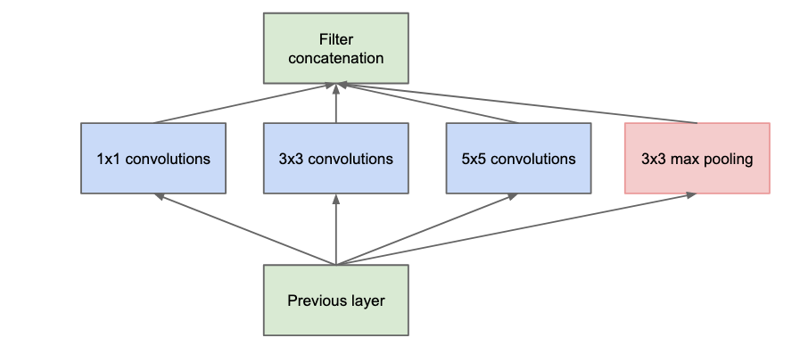
Inception

Slide 26
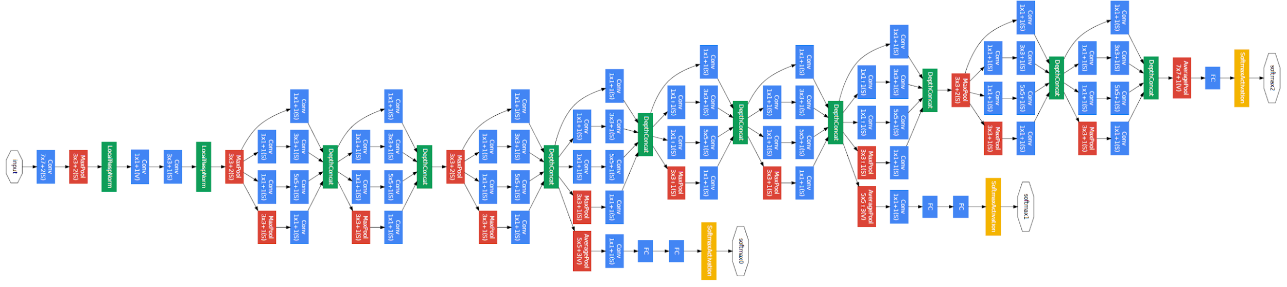
GoogLeNet

Slide 27
ResNet

Slide 28
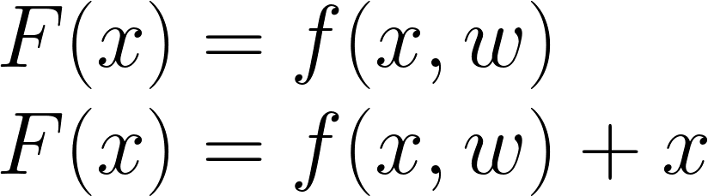
Residual Connection

Slide 29
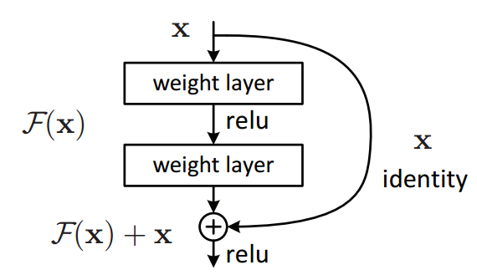
Residual Connection

Slide 30
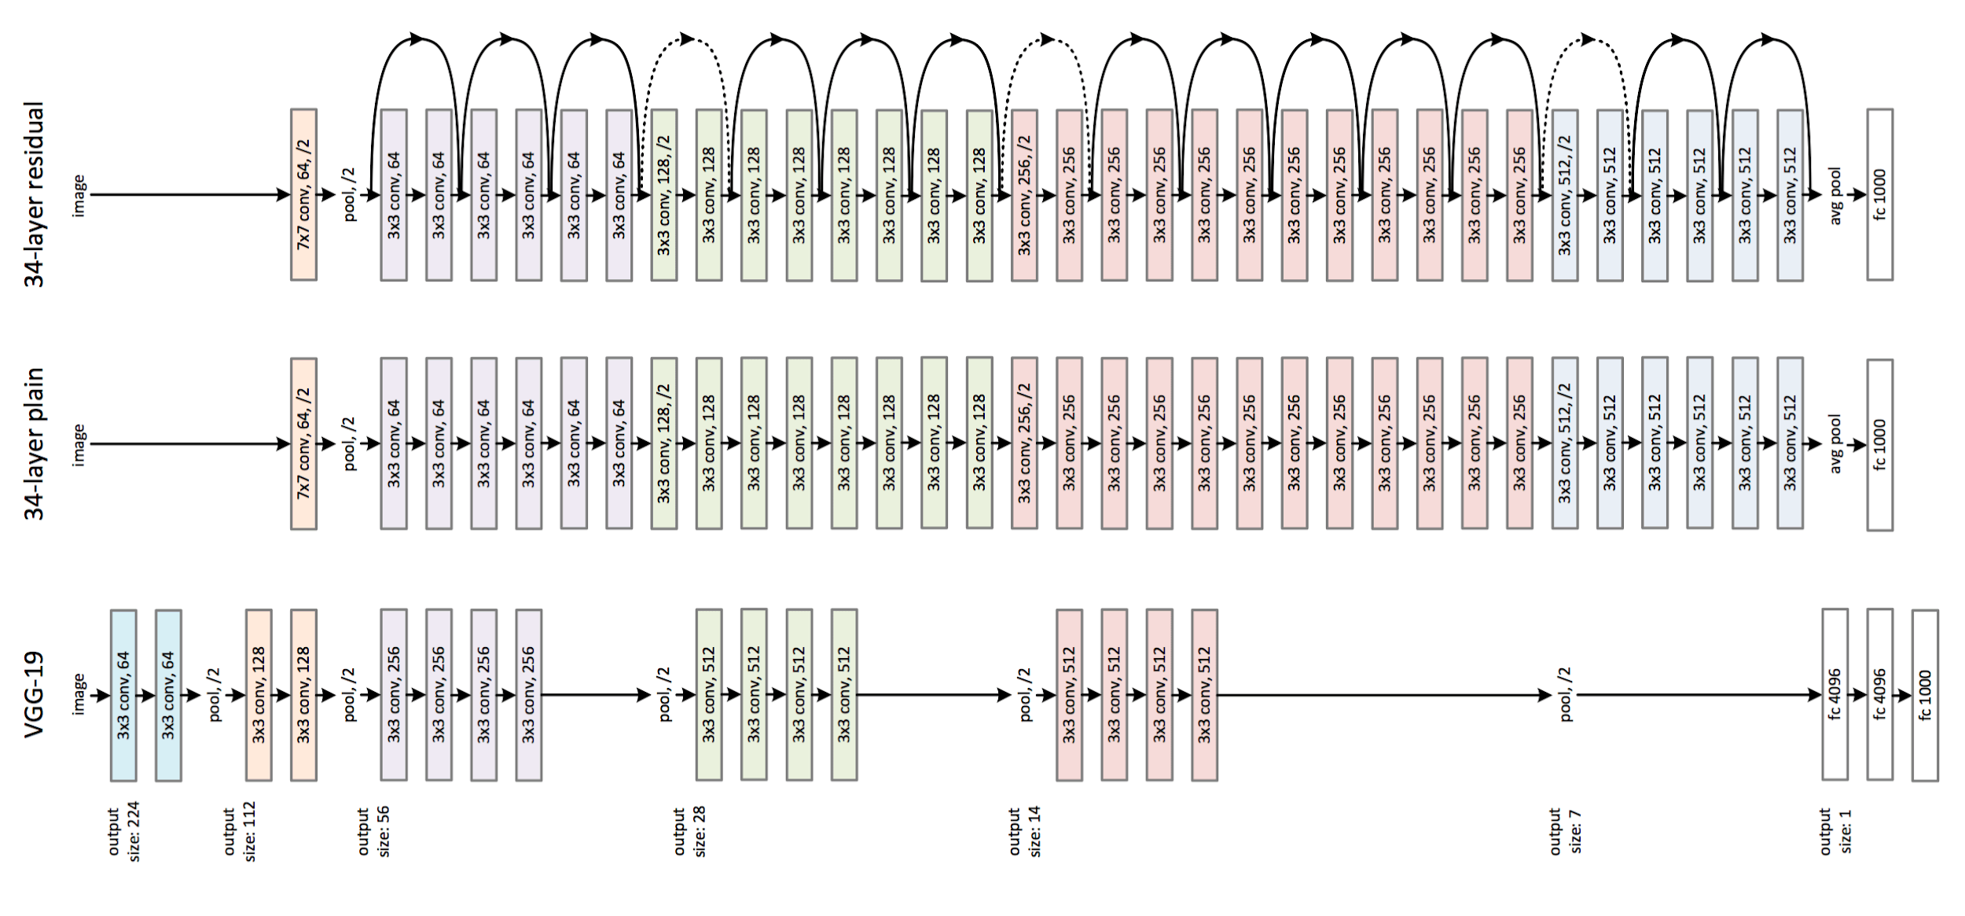
ResNet

Slide 31
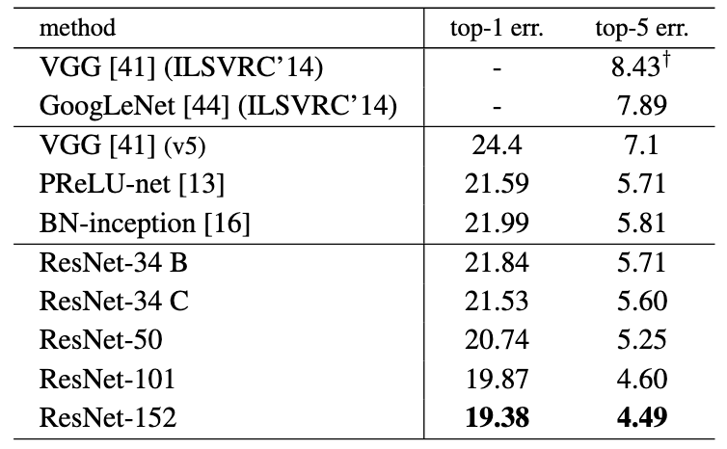
ResNet

Slide 32
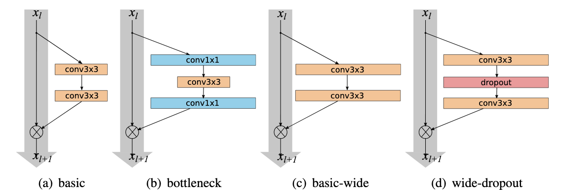
Wide ResNet

Slide 33
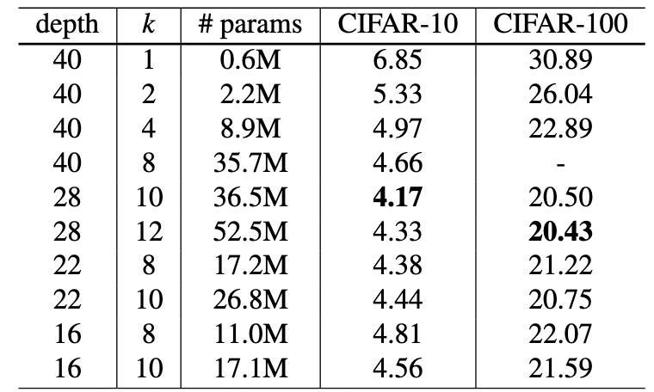
Wide ResNet

Slide 34
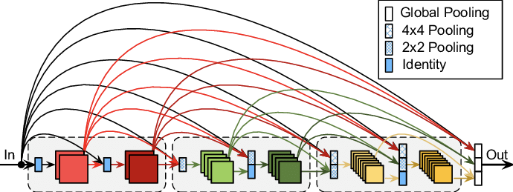
DenseNet

Slide 35
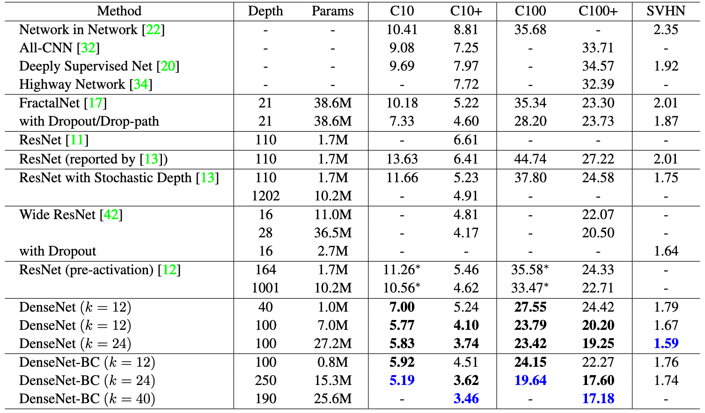
DenseNet

Slide 36
Transfer Learning

Slide 37
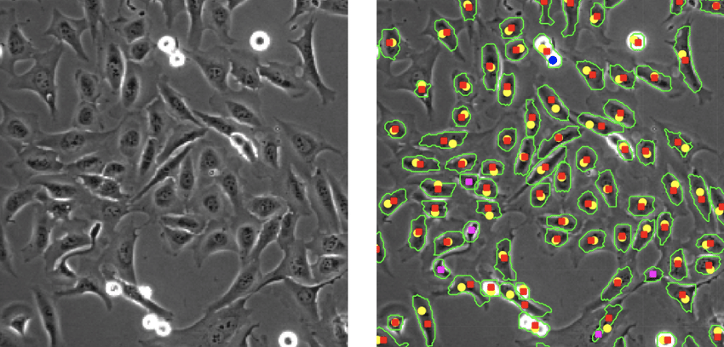
Transfer Learning

Slide 38
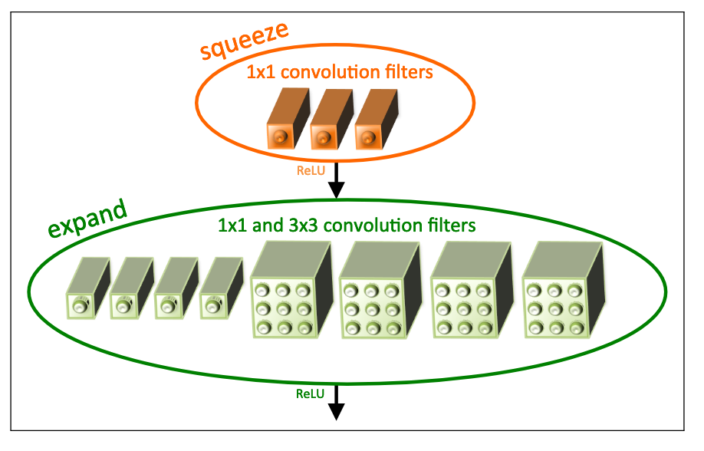
SqueezeNet

Slide 39
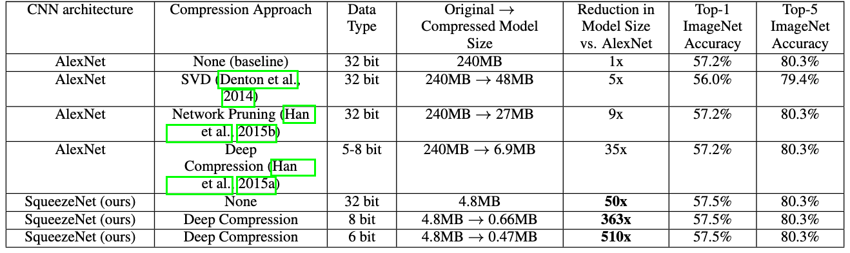
SqueezeNet

Slide 40
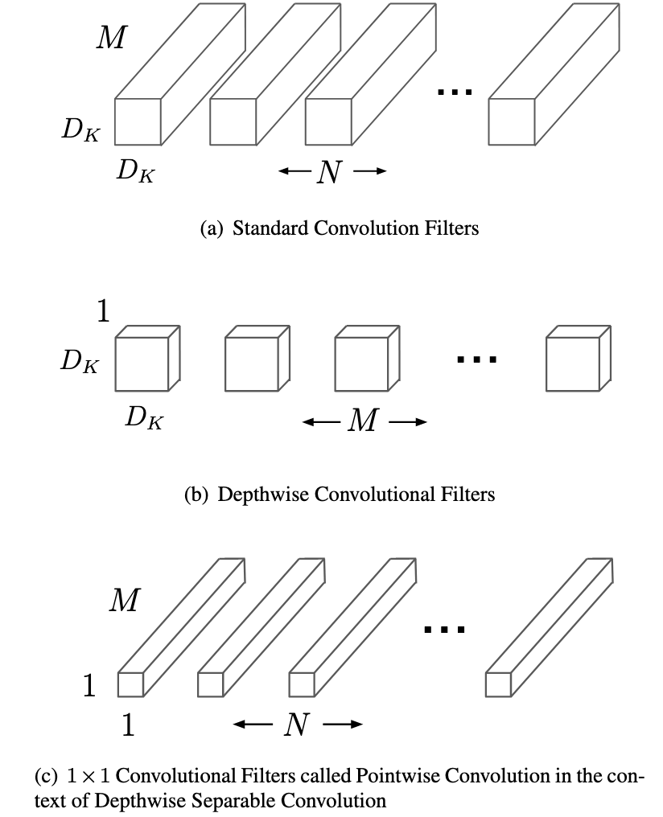
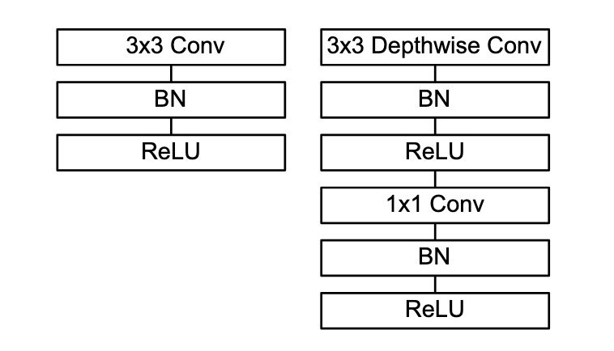
MobileNet

Slide 41
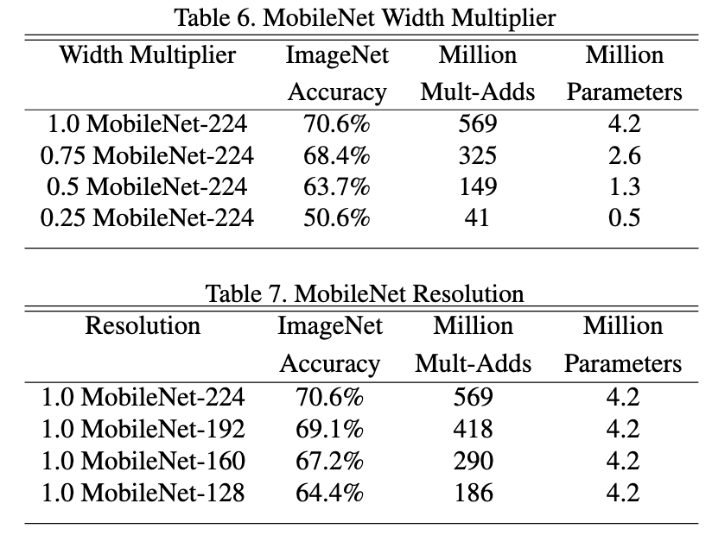
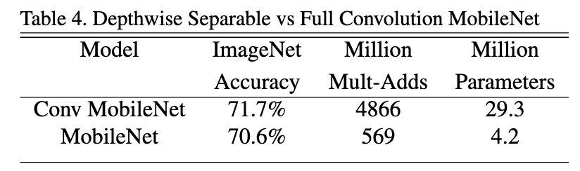
MobileNet

Slide 42
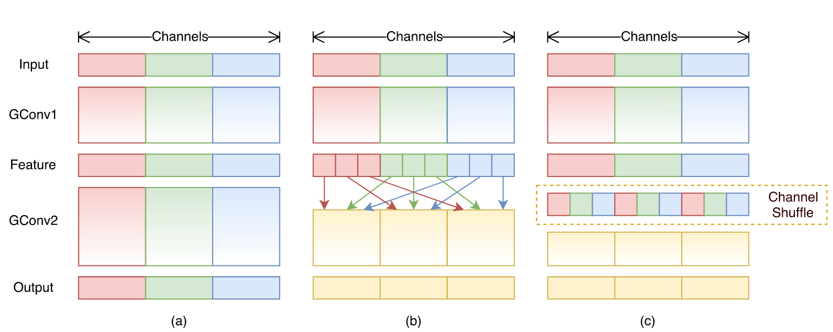
ShuffleNet

Slide 43
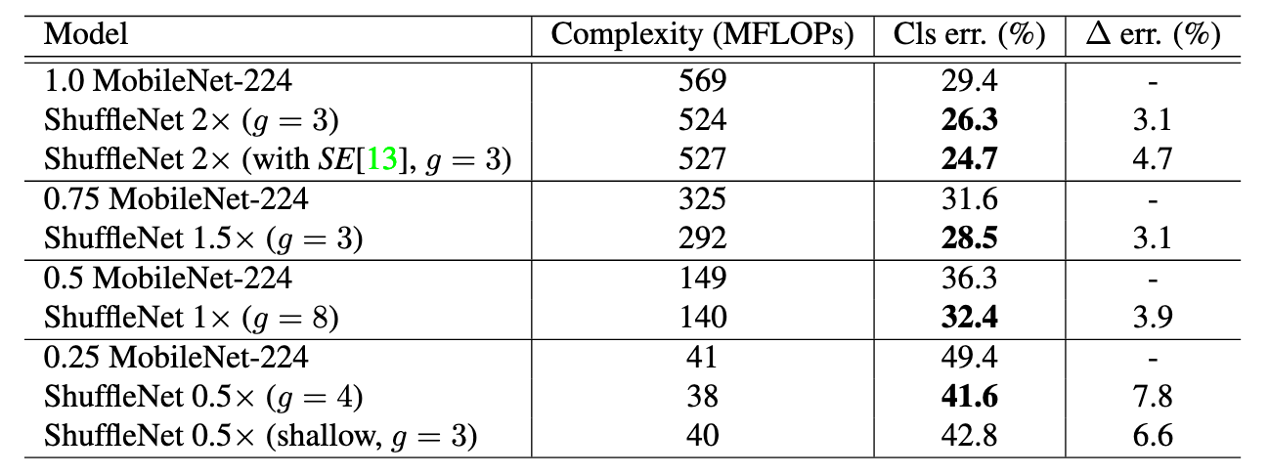
ShuffleNet

Slide 44
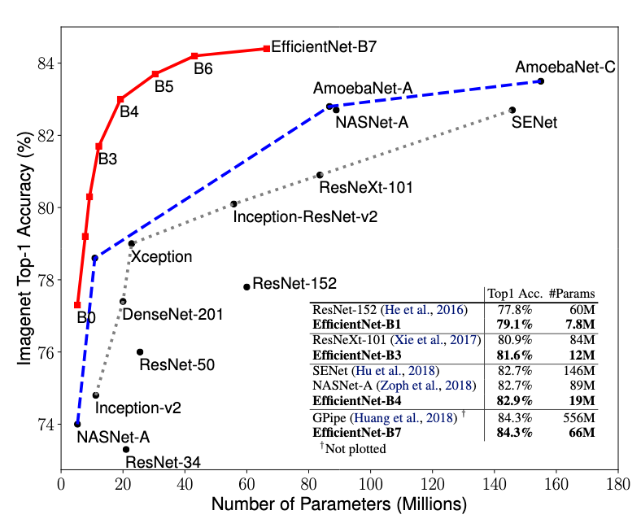
NAS, EfficientNet

Slide 45
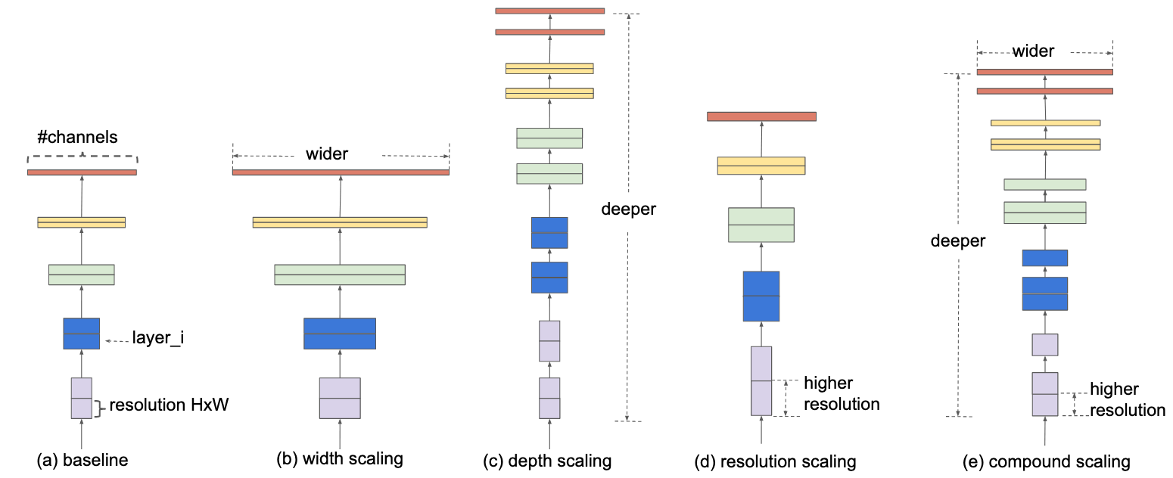
NAS, EfficientNet

Slide 46
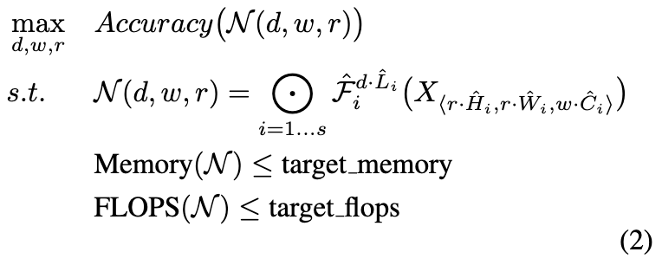
NAS, EfficientNet

Slide 47
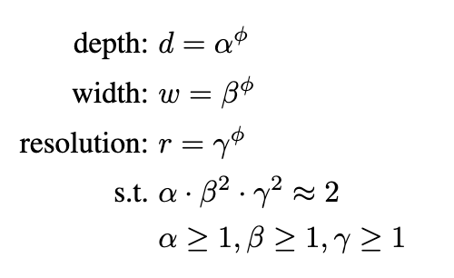
NAS, EfficientNet

